Slide 1
Zenject & Unity
By Karissa (Ari) Stisser (Software Engineer)

Slide 2

Karissa Stisser (My Background)
Marine Corps
Standalone software projects
Databases, GUIs, Signal Processing, Image processing, Android, MATLAB… now Unity
Java, Python, Spring, Hibernate, Midas, Ruby, COSMOS, Jenkins, C++, now C#
BS in CS @ UIS
MS in CS @ Georgia Tech

Slide 3
Resources
https://github.com/kstisser/KibbleCatch
https://github.com/modesttree/Zenject

Slide 4
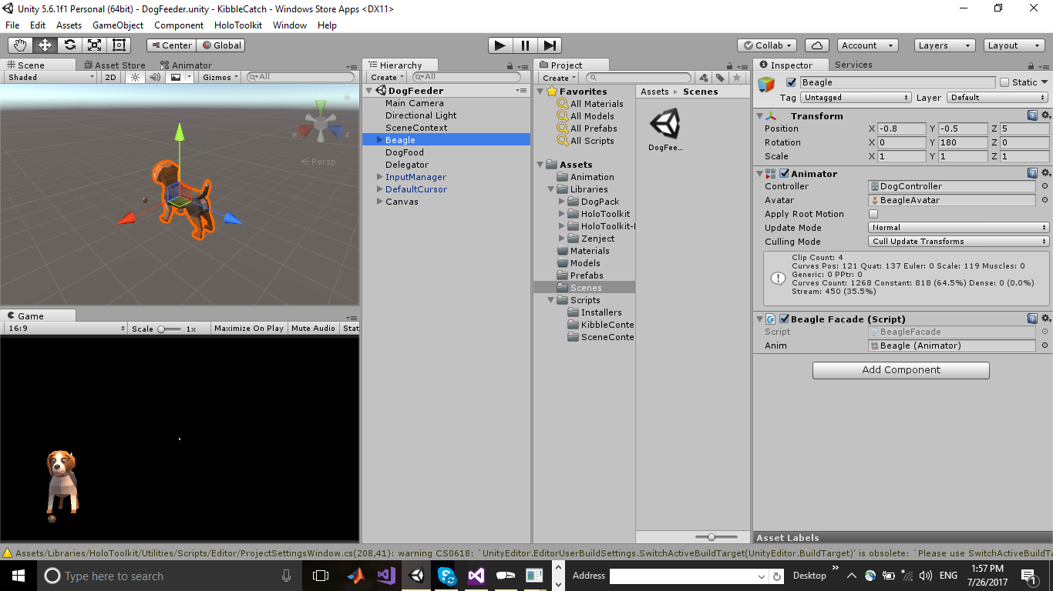
Unity Component Based Architecture
Game Objects
Decoupled/Modular
Readable
Reusable

Slide 5
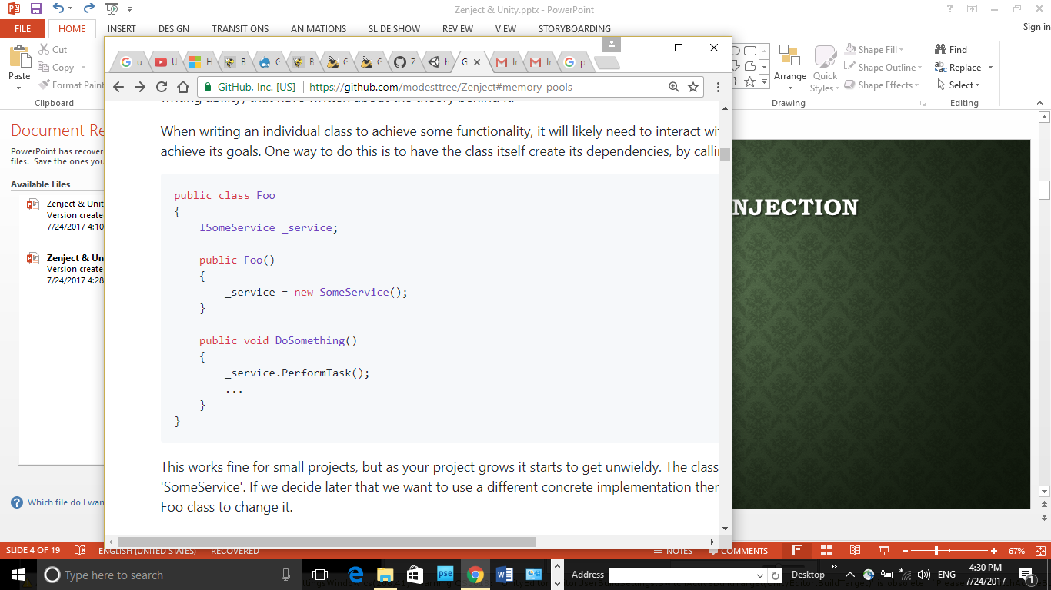
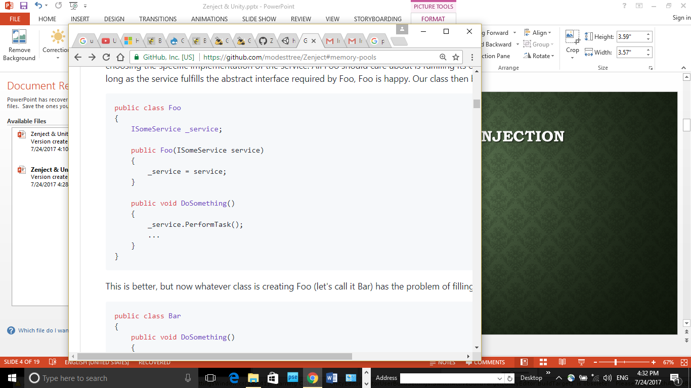
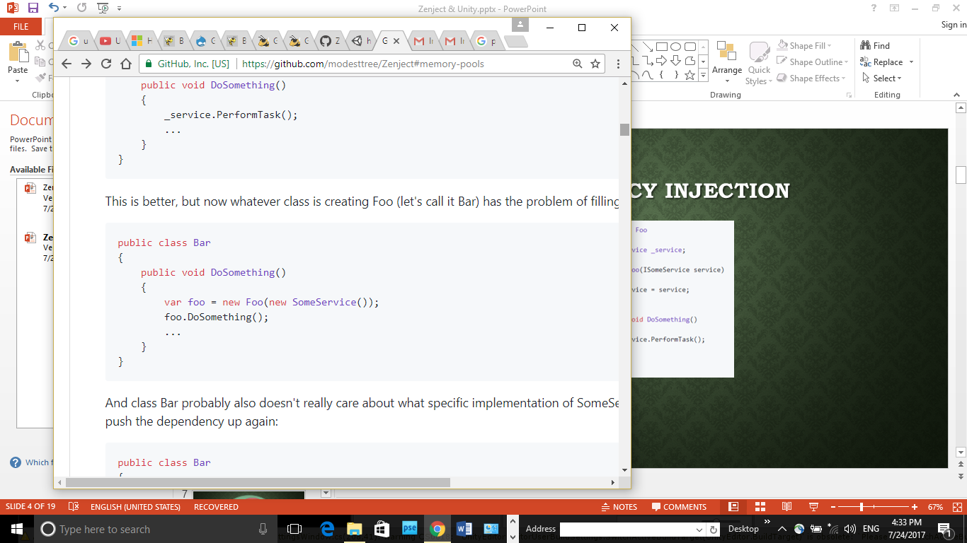
Dependency injection

Slide 6
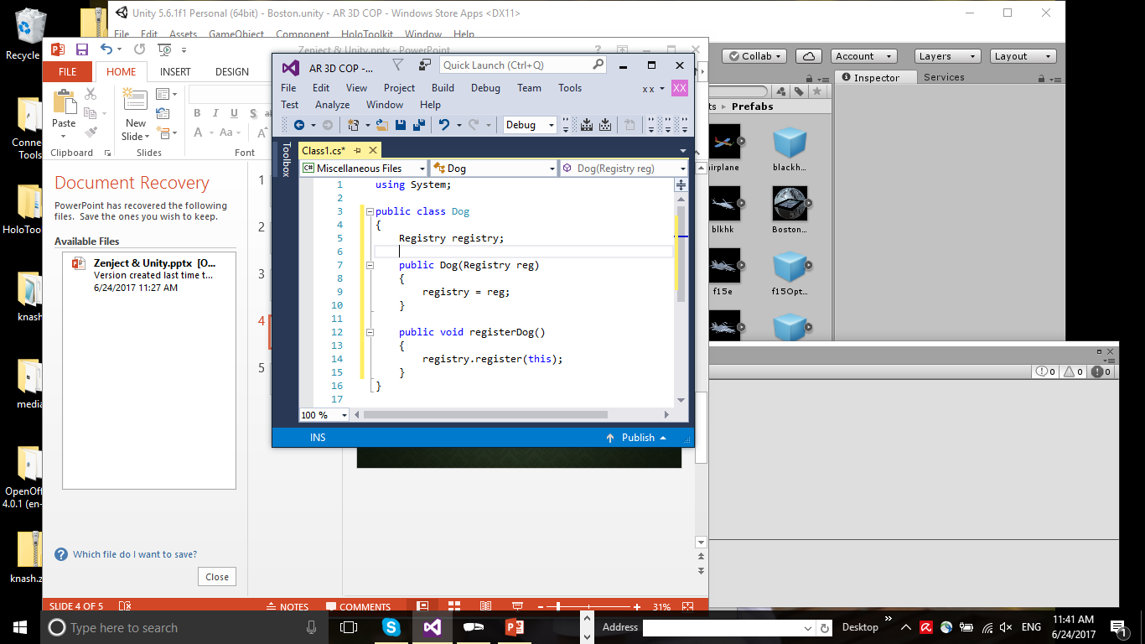
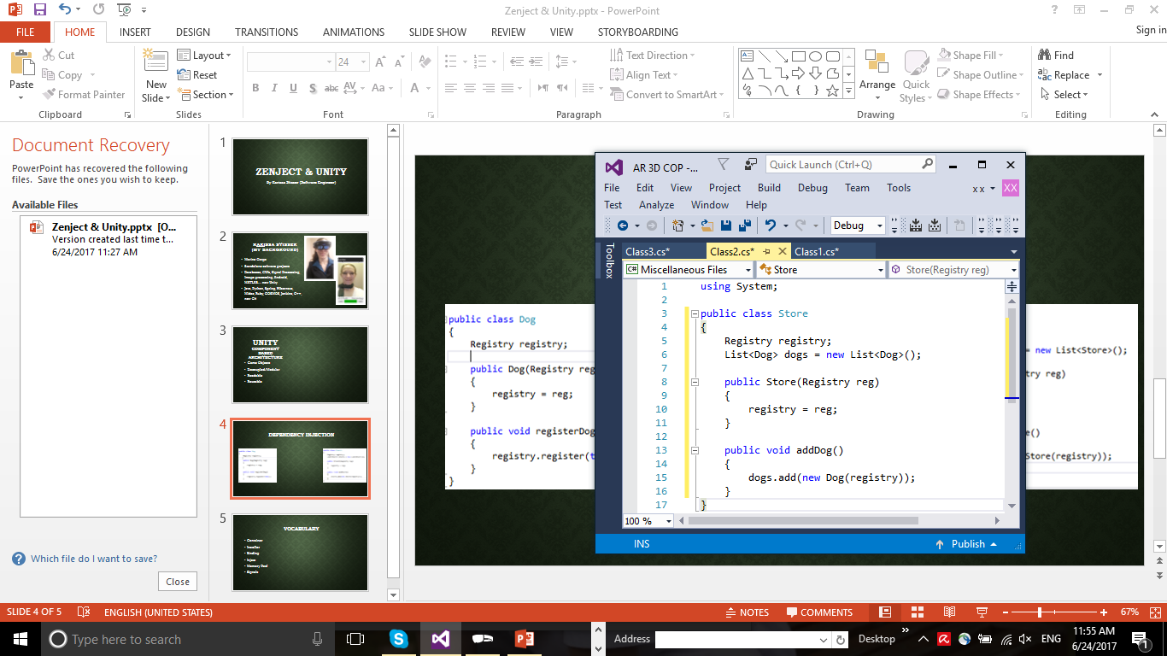
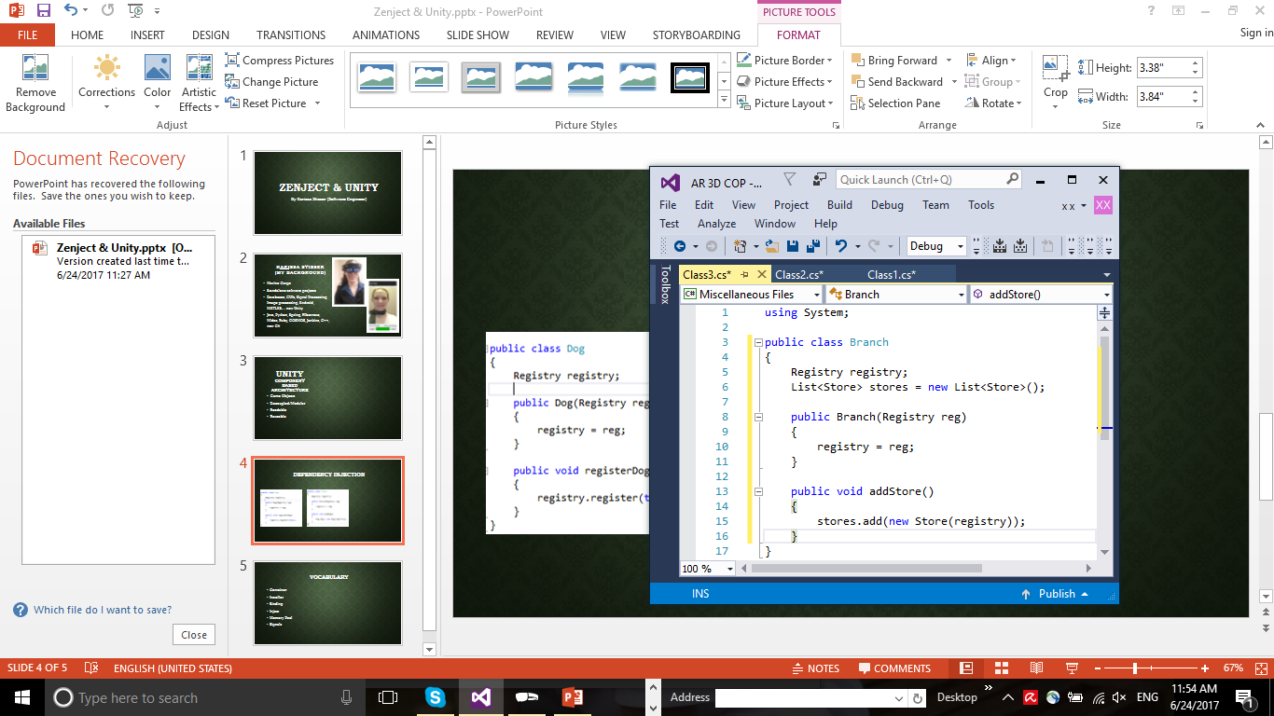
Dependency Injection
Single Purpose
Open/Close principle
Testing

Slide 7
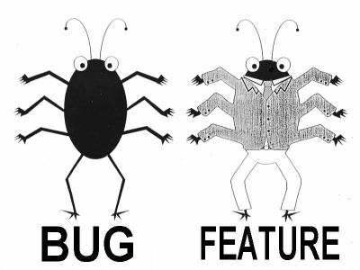

Slide 8
Project Context
Scene Context
Game
Context
Game
Context
Game
Context
Scene Context
Game
Context
Game
Context

Slide 9

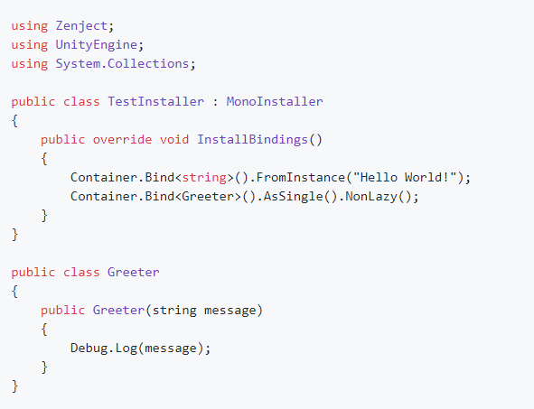
Vocabulary
Container
Installer (script)
Binding
Inject
Signals
Memory Pool

Slide 10
Color Codes
Binding injections in an Installer
Injected values in script
Signals
Memory Pool

Slide 11
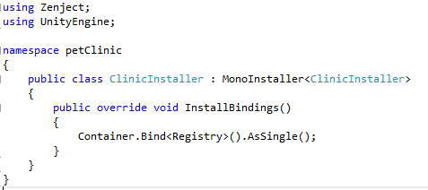
How To Inject
Step 1
Container.Bind<ContractType>()
.To<ResultType>()
.WithId(Identifier)
.FromConstructionMethod()
.AsScope()
.WithArguments(Arguments)
.When(Condition)
.CopyIntoAllSubContainers()
.NonLazy();
.AsCached(), .AsSingle(), .AsTransient()
Bind your dependency in your installer

Slide 12
How To Inject
Step 1 (continued)
Bind your dependency in your installer
Container.Bind<Foo>().AsSingle();
Container.Bind<IBar>().To<Bar>().AsSingle();
Container.BindInstance(“Hello World”);
Container.BindInstance(new Foo()).WhenInjectedInto<ResultType>();
Container.Bind<Foo>().FromMethod(someMethod);
Container.Bind<Bar>().FromFactory<BarFactory>();
Container.Bind<Foo>().FromComponentInNewPrefab(somePrefab);
Container.Bind<Foo>().FromNewComponentOnNewGameObject();
Container.Bind<Foo>().FromComponentInChildren();
Container.BindInterfacesAndSelfTo<Foo>().AsSingle();

Slide 13
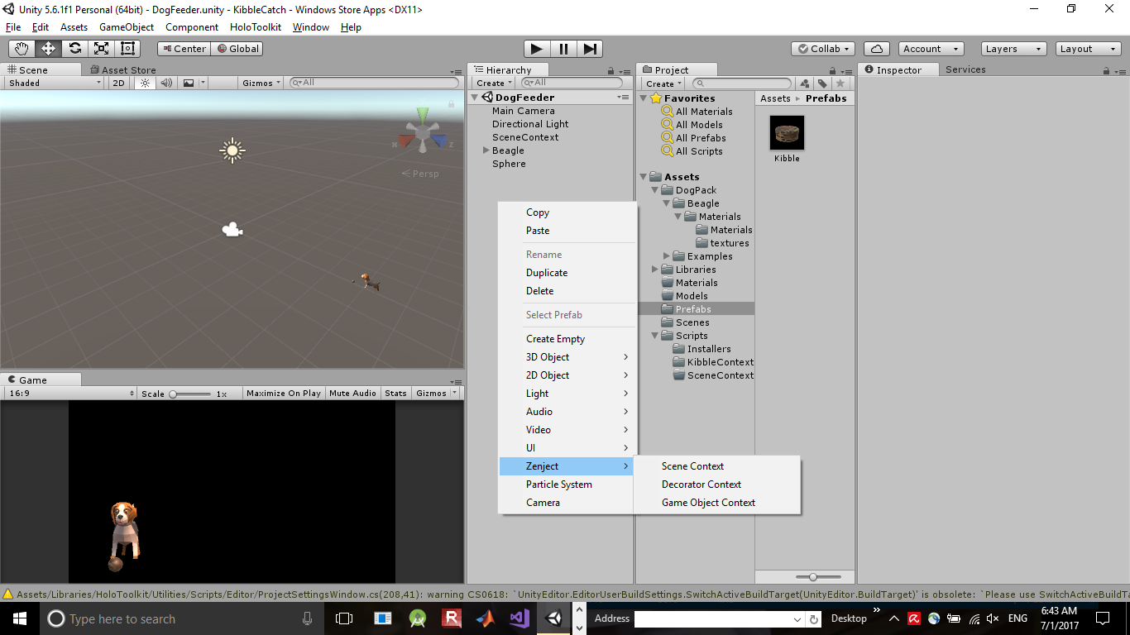
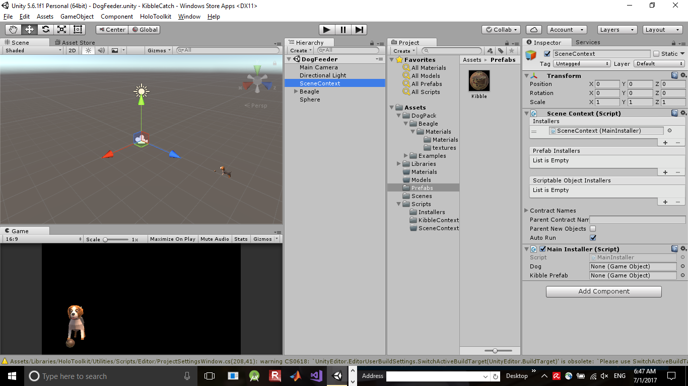
Scene Context
Establish a Scene Context, attach Installer

Slide 14
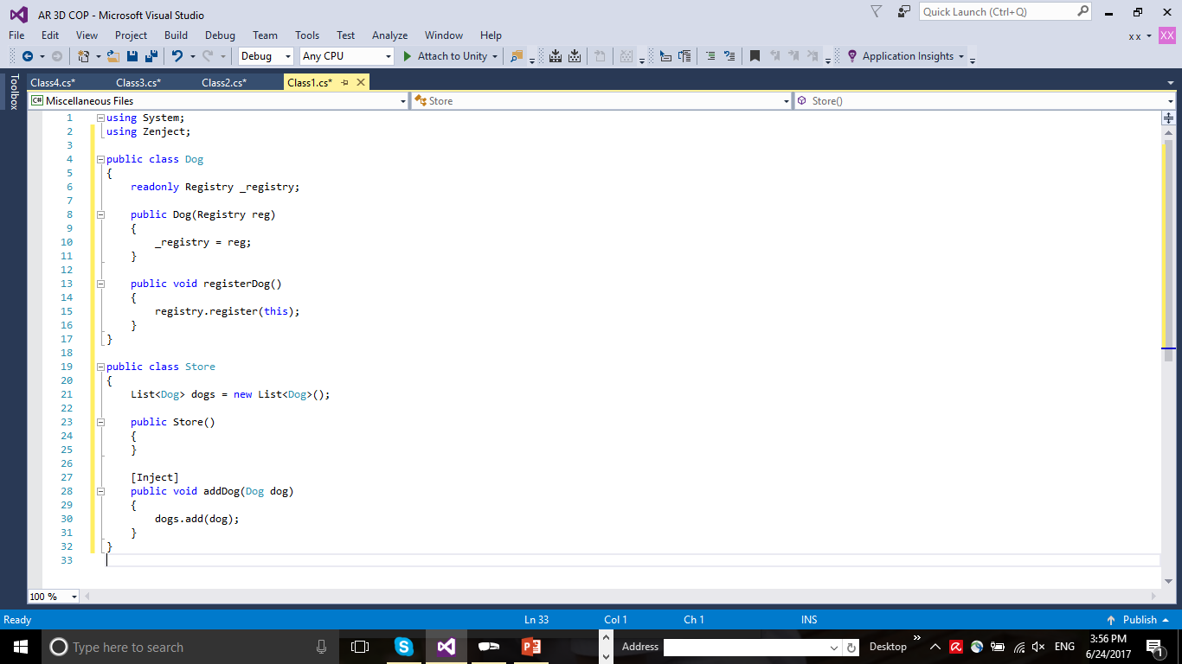
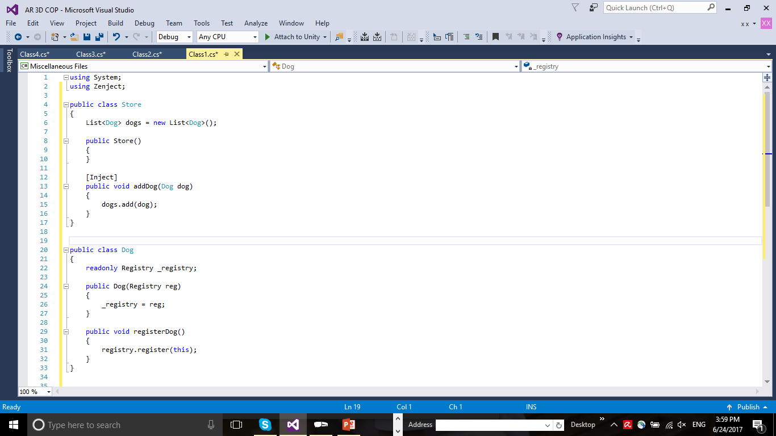
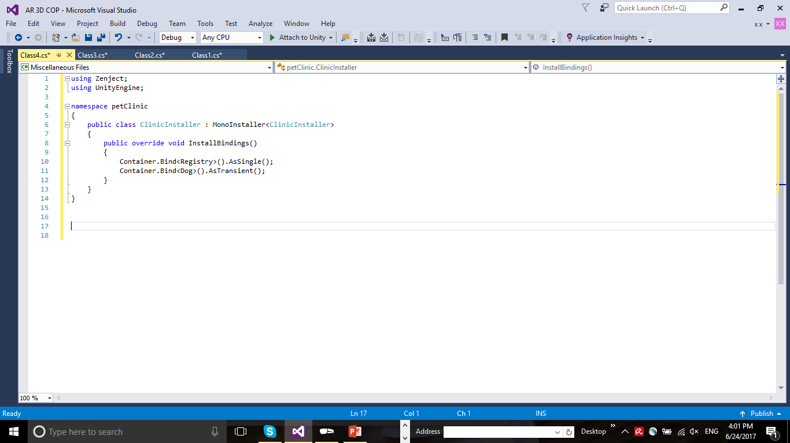
How To Inject
Step 2
Inject your dependency into your class: Objects & Methods

Slide 15
Reminder: MonoBehaviour
Public class Dog : MonoBehaviour
{
void OnStart()
{
}
void Update()
{
}
void OnDestroy()
{
}
}

Slide 16
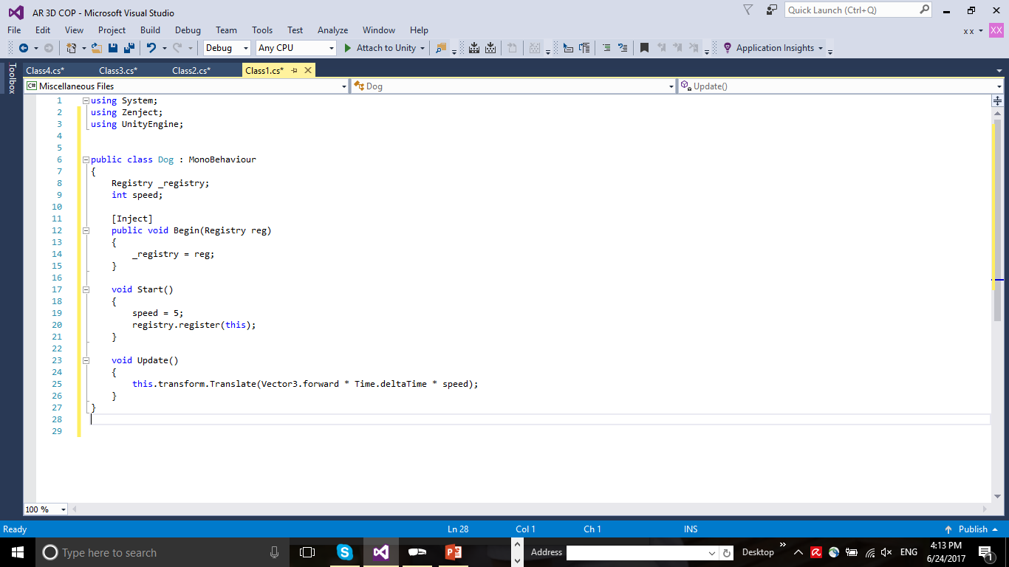
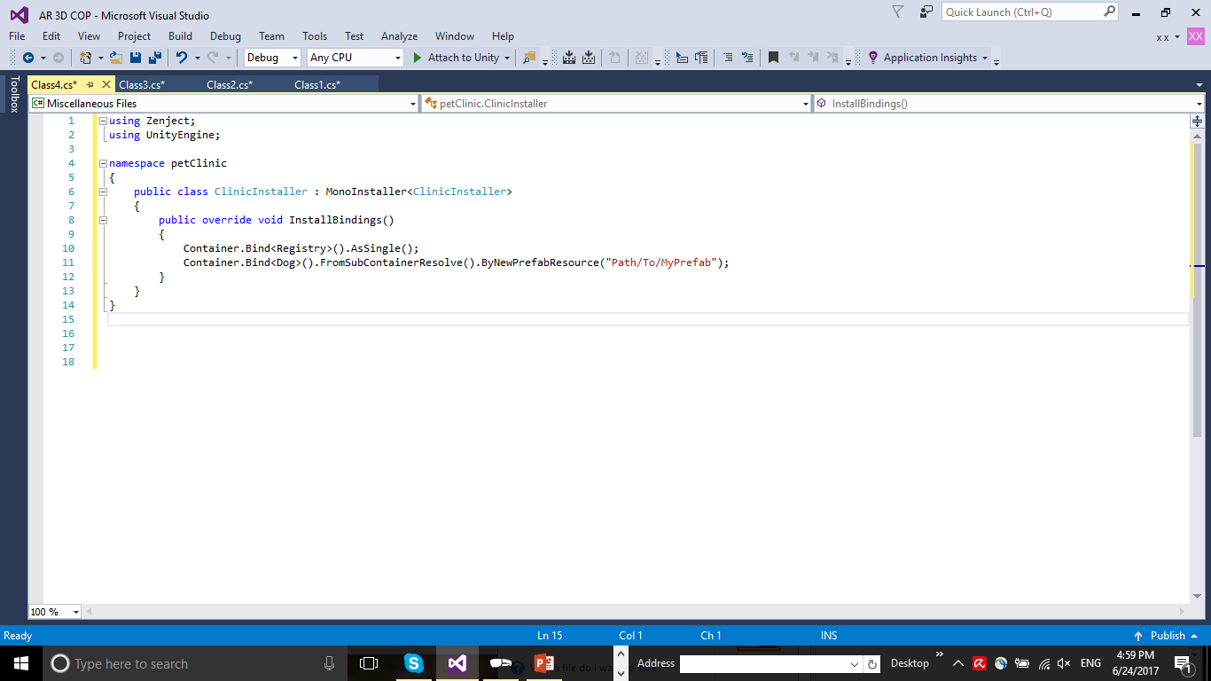
How To Inject
Step 2
Inject your dependency into your class: MonoBehaviour

Slide 17
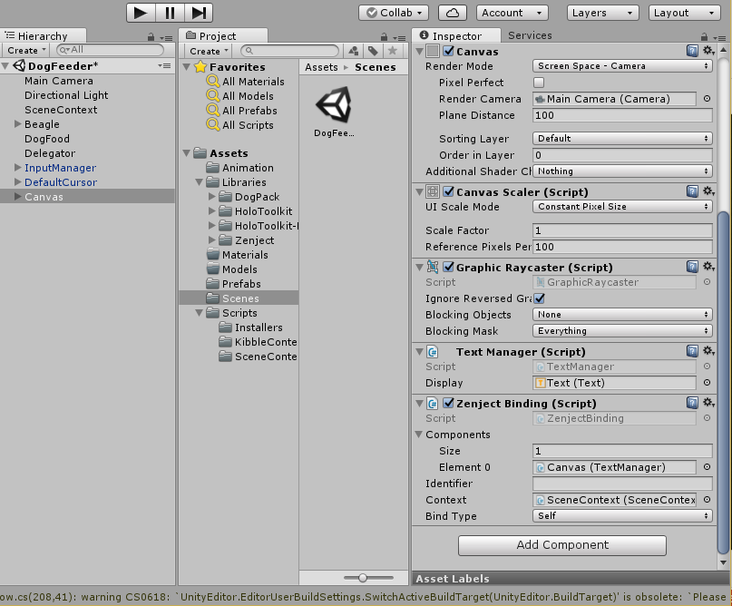
How To Inject
Inject your dependency into your class: MonoBehaviour
Step 2

Slide 18
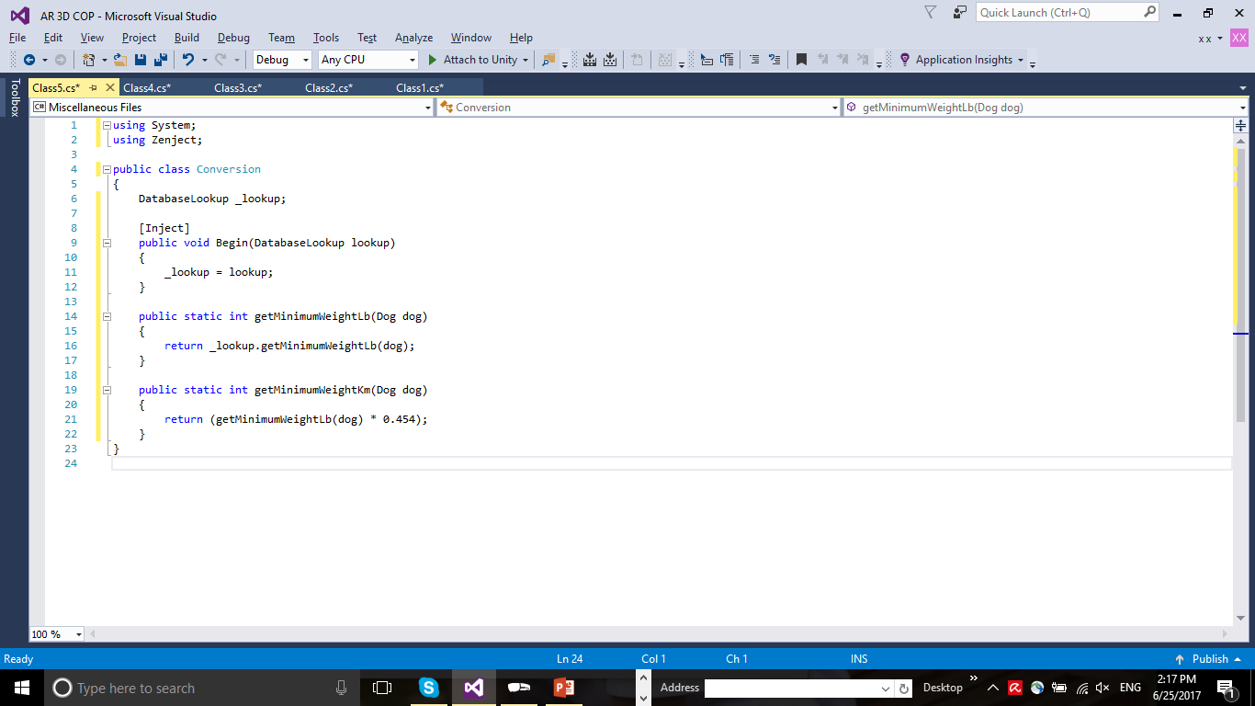
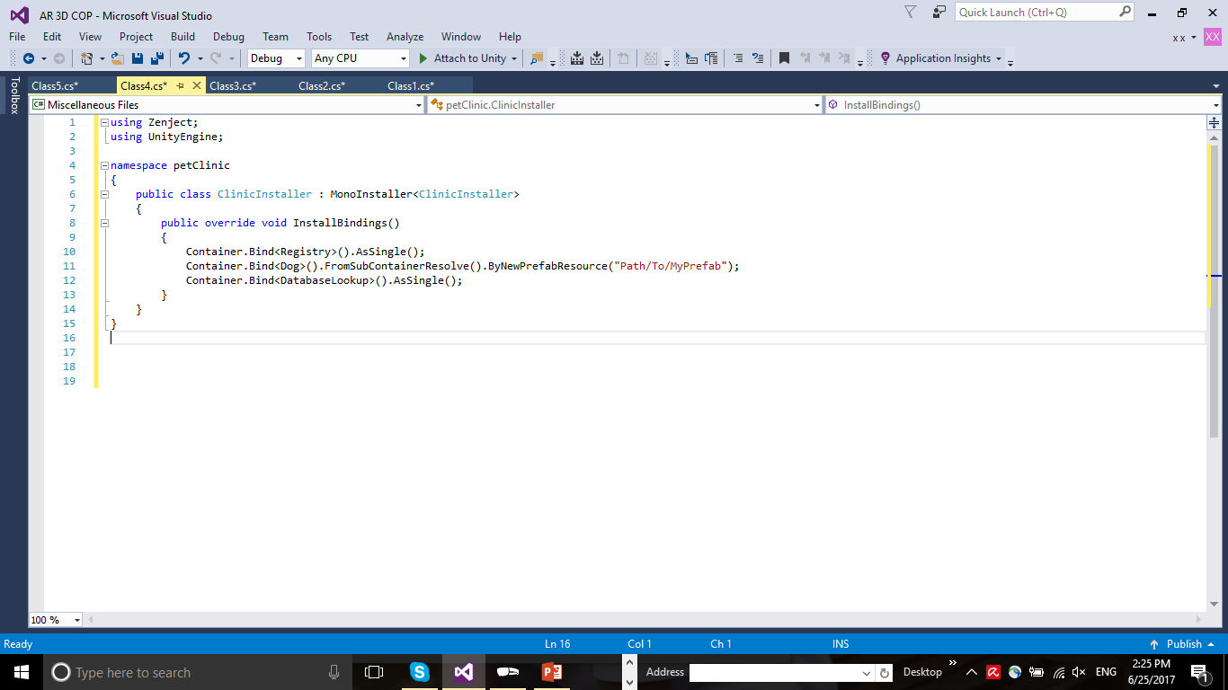
How To Inject
Step 2
Inject your dependency into your class: Supportive Class

Slide 19
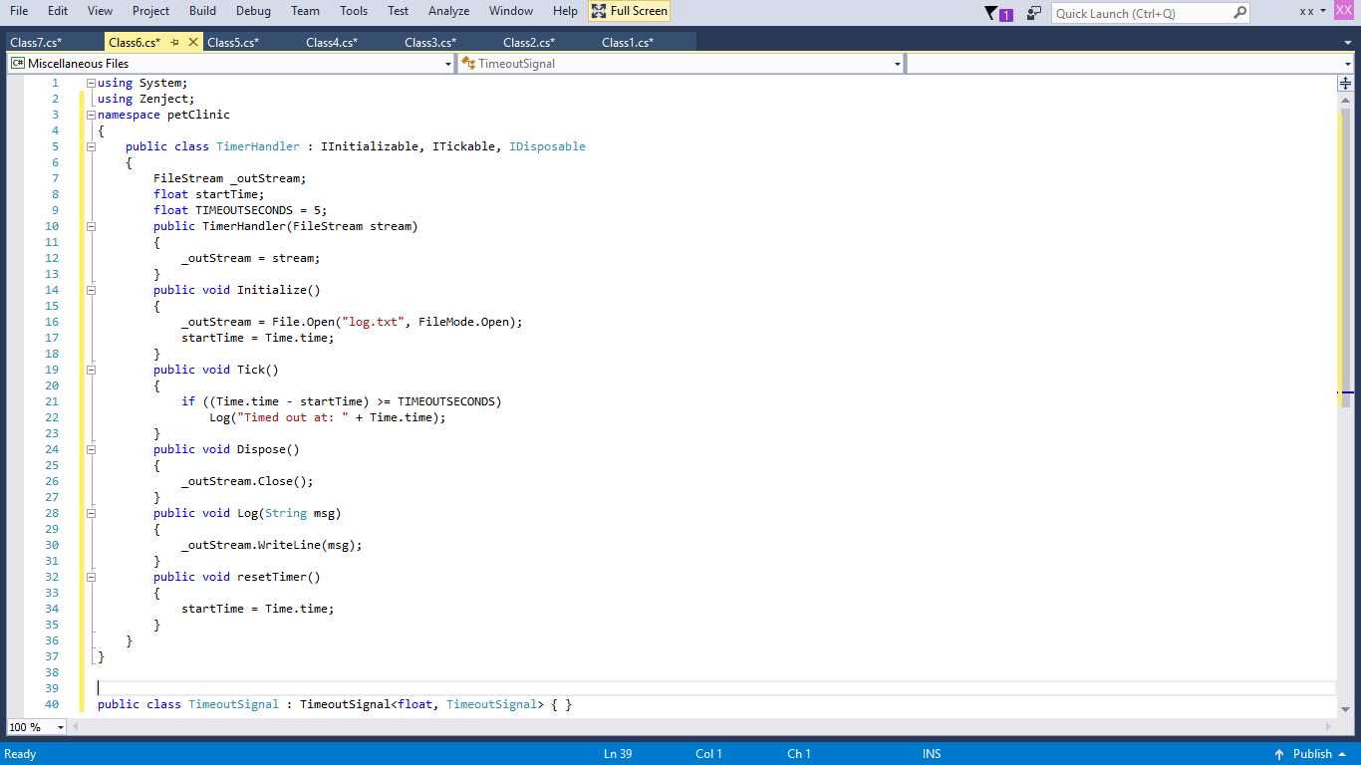
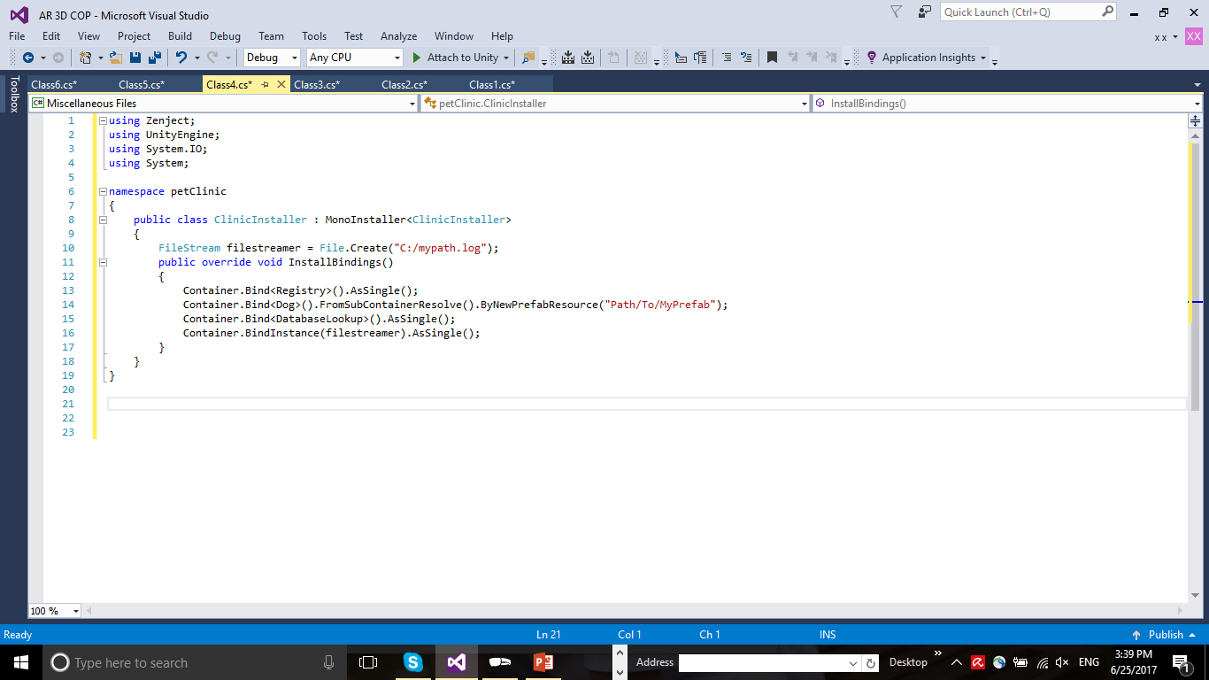

How To Inject
Step 2
Inject your dependency into your class: IInitializable, ITickable, IDisposable

Slide 20
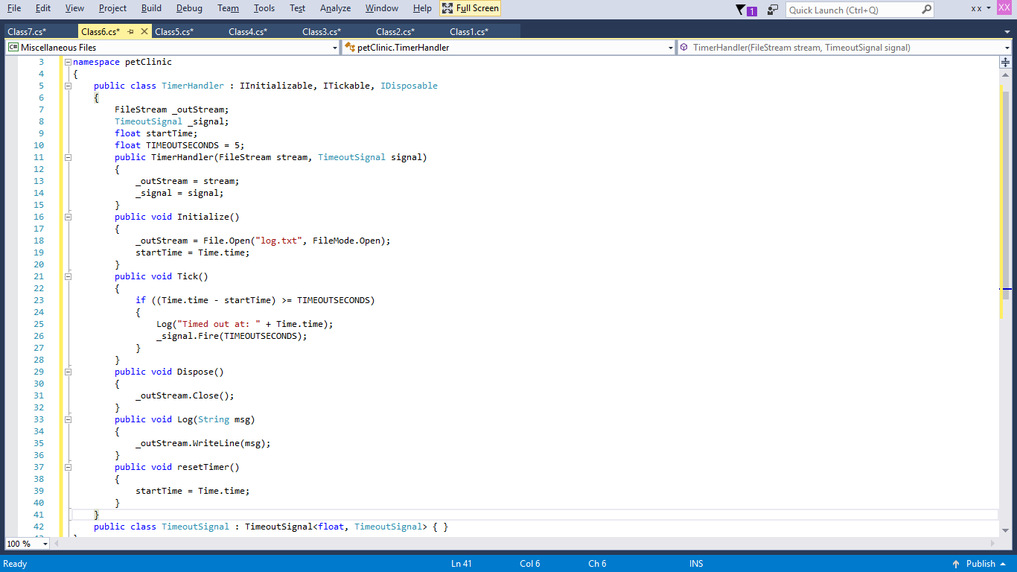
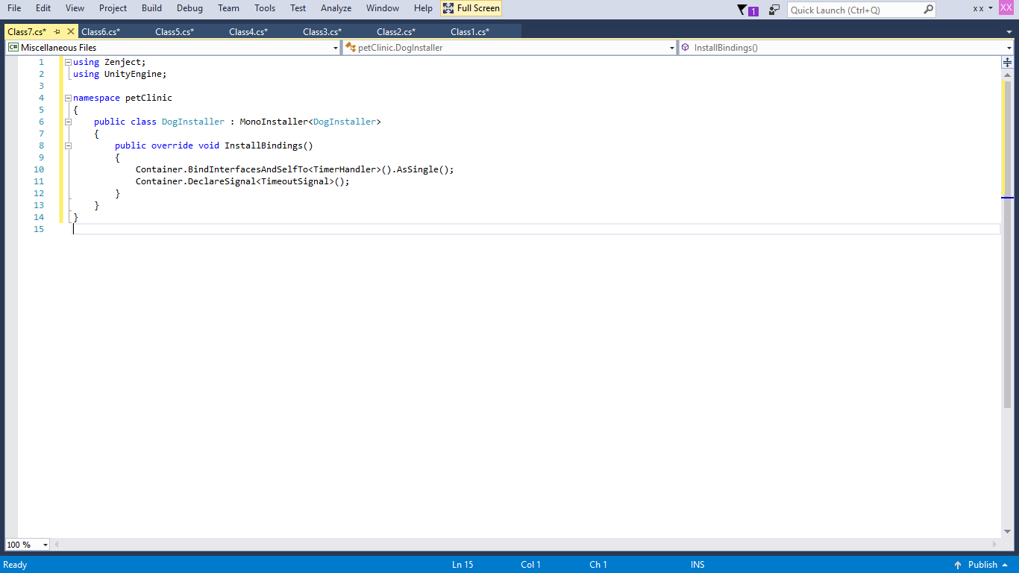
Signals
Allows for communication between classes

Slide 21
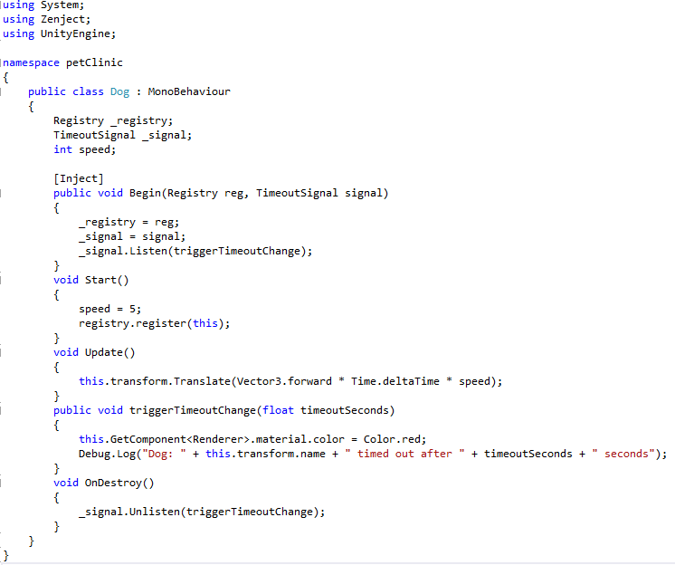
Signals
Allows for communication between classes

Slide 22
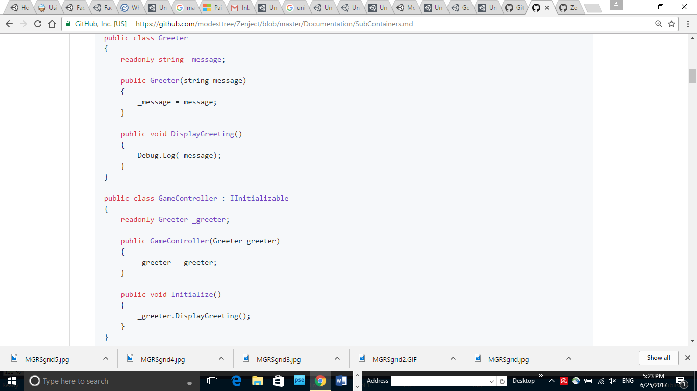
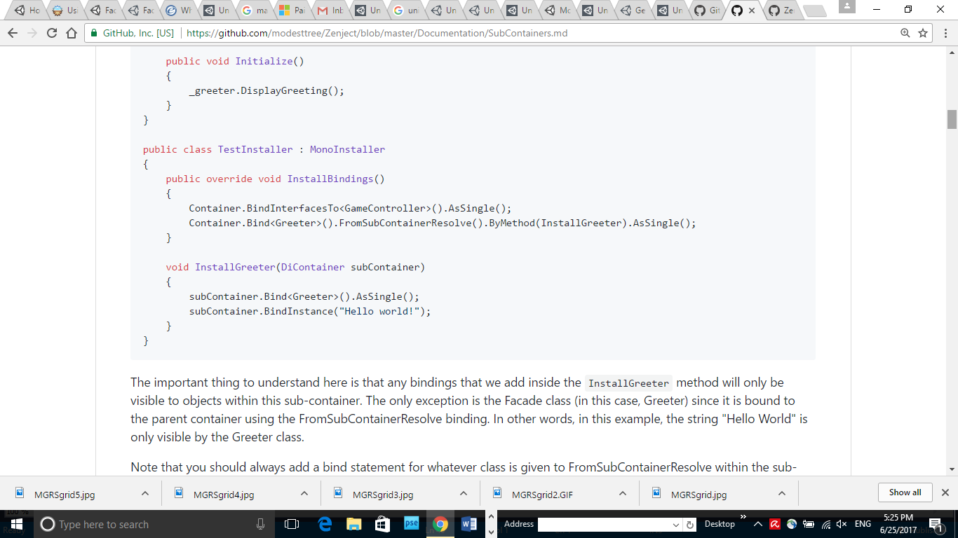
SubContainer
Façade
MonoBehaviour facilitator
Bindings are only visible to other objects in the subcontainer

Slide 23
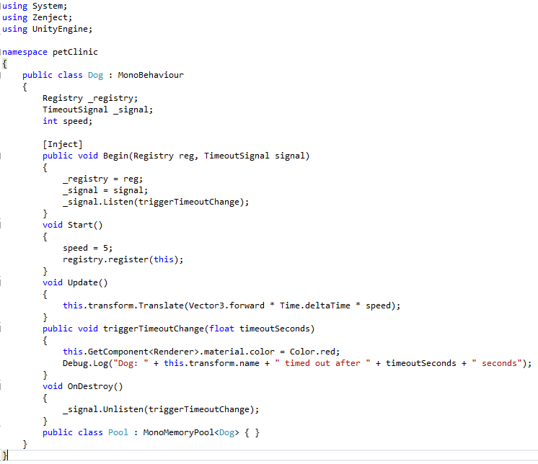
Memory Pool
Provides greater efficiency in creation and destruction

Slide 24
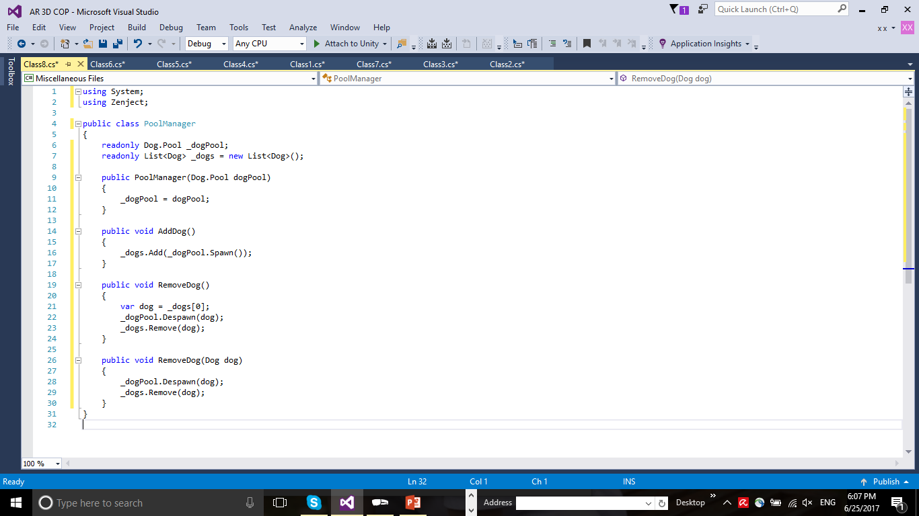
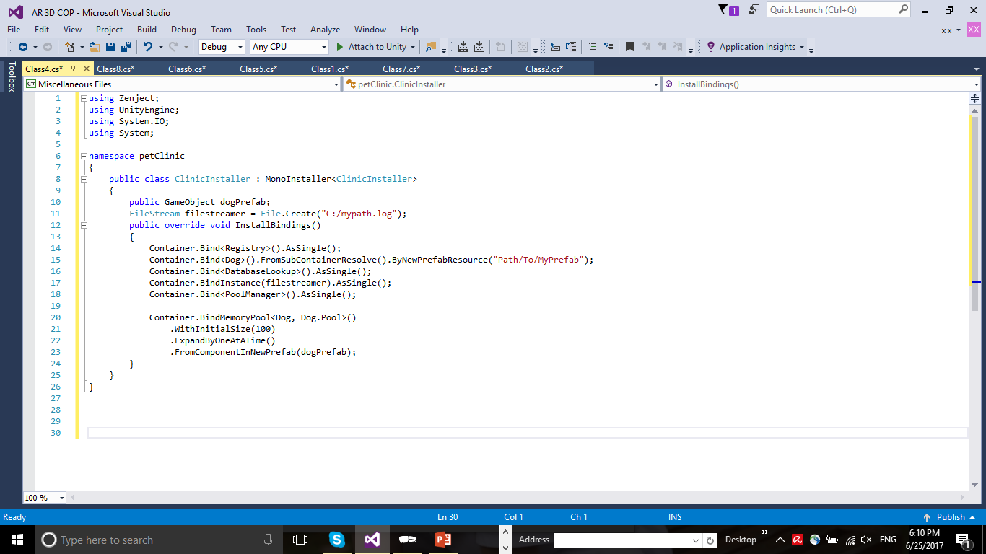
Memory Pool
Provides greater efficiency in creation and destruction

